Slide 1


PLATELET ACTIVATION IN TRAUMA AND OTHER INFLAMMATORY CONDITIONS
Samantha J Montague
03.04.2017
Who/Where/What/How

Slide 2

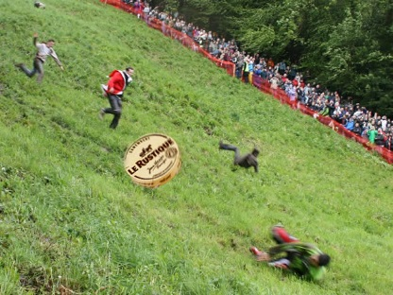
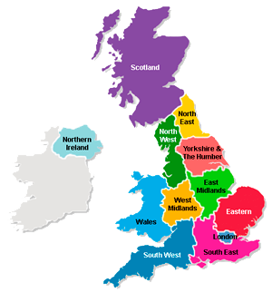
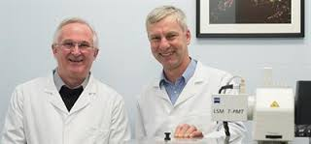

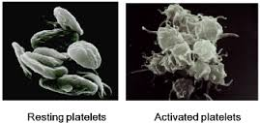


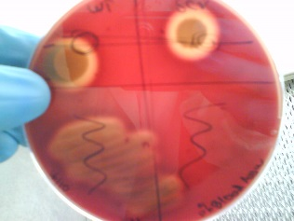
SCVs

Slide 3
Platelets and Trauma
Trauma
Severe haemorrhage
Inflammation
Infection
Wound healing
Sepsis
Systemic inflammatory response syndrome (SIRS)
Multiple Organ Failure (MOF)
Notes:
Identify any potential therapeutics/drug targets

Slide 4
Project Aims:
Overall Aim: Understand the role of platelets in trauma, inflammation and wound repair
Identify the effects of DAMPs and Alarmins on platelet activation
Investigate the cleavage of GPVI and establish whether soluble GPVI is a marker of platelet activation in trauma and inflammation
Explore the consequences of podoplanin upregulation in inflammation
Investigate the role of platelet receptors in wound repair

Slide 5
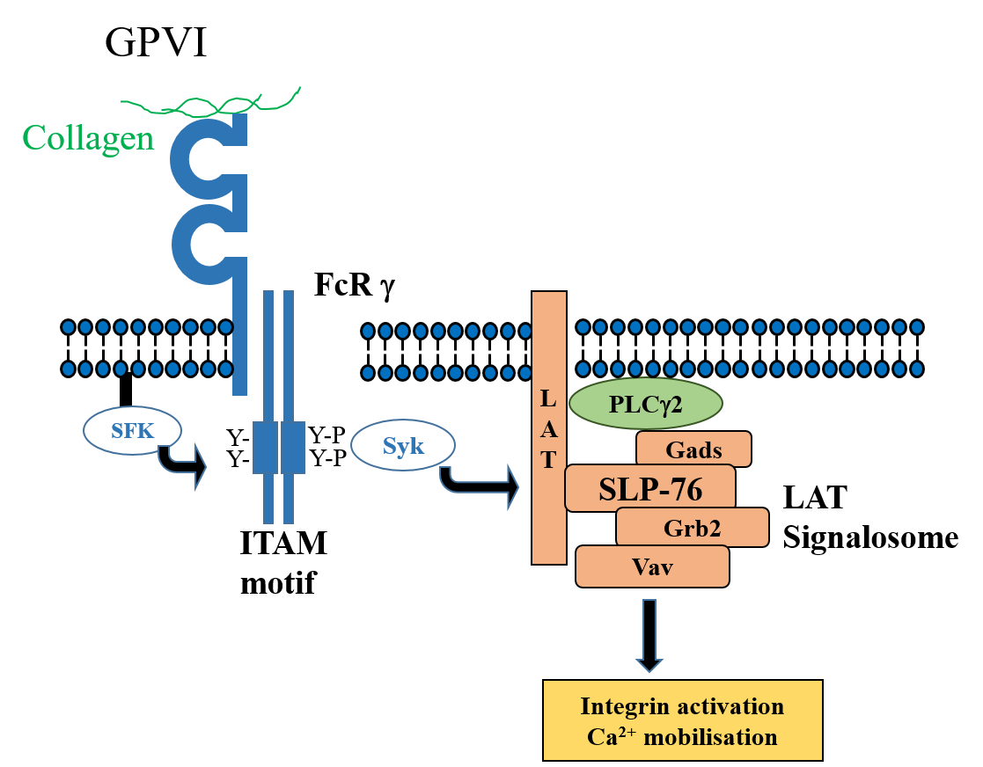
Platelet receptors of interest

Slide 6
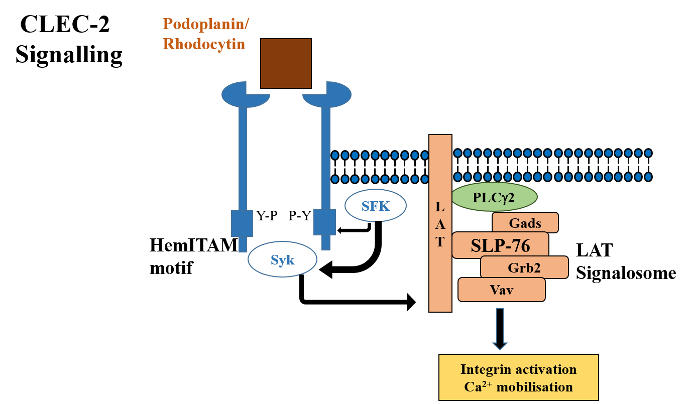
Platelet receptors of interest

Slide 7
Main findings
Histone-mediated platelet activation is GPVI dependent in vitro but multiple mechanisms are involved in histone-mediated aggregation in vivo.
Fibrin-mediated GPVI shedding is dependent on multiple sheddases including ADAM10
> Elevated sGPVI in inflammation maybe mediated by fibrin
Podoplanin is upregulated only on LPS stimulated macrophages but not sufficient to induce platelet activation
GPVI has a potential role in wound healing

Slide 8


Fibrin stimulation of platelets induces GPVI shedding

Slide 9
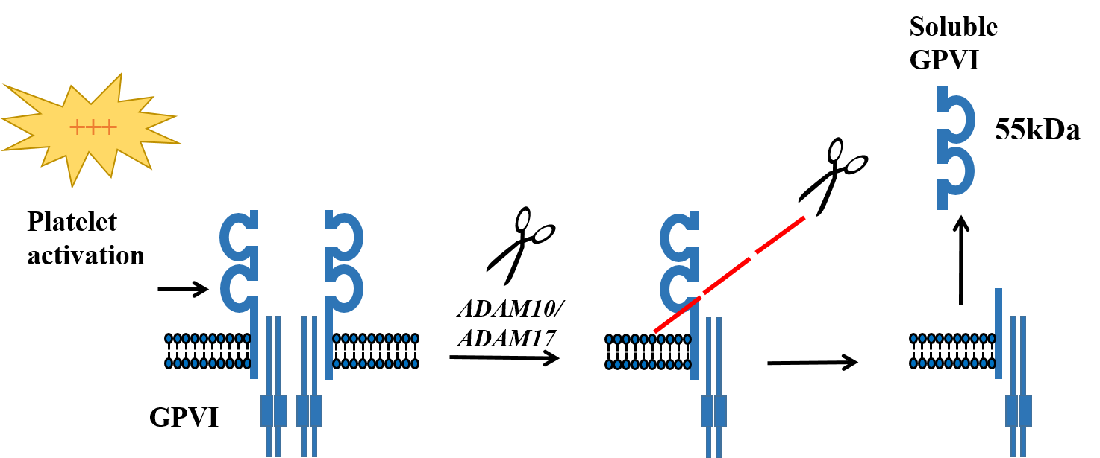
Soluble GPVI (sGPVI) is release into the plasma after GPVI cleavage
Collagen/CRP/Convulxin
Chemical agents – NEM/Calcium ionophore
FcγRIIA and CLEC-2 activation
Shear Stress
FX activation
sGPVI detected by ELISA
Cytoplasmic tail detected by an anti-GPVI antibody

Slide 10
sGPVI is elevated in a range of thrombotic and inflammatory conditions
Elevated in:
Ischaemic stroke (Wurster et al. 2013; Platelets, Al-Tamimi et al. 2011; Stroke)
Microangiopathy (Yamashita et al. 2014; Thromb Res)
Immune thrombocytopenic purpura
(ITP) (Gardiner et al. 2008; JTH)
Disseminated intravascular coagulation
(DIC) (Al-Tamimi et al. 2011; Blood)
Can sGPVI be a marker of platelet activation in trauma and inflammation?

Slide 11
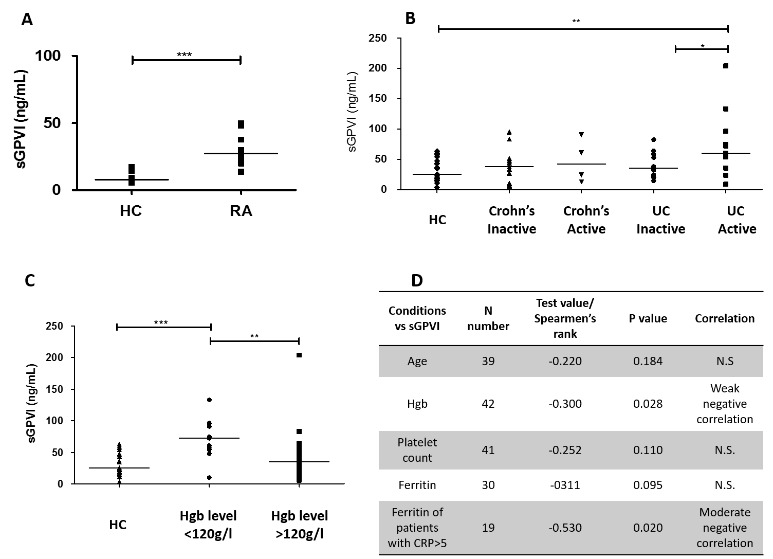
sGPVI is elevated in patients with chronic inflammatory conditions
sGPVI elevated in patients with rheumatoid arthritis (RA) (n=10)
sGPVI elevated in patients with active ulcerative colitis (UC)

Slide 12
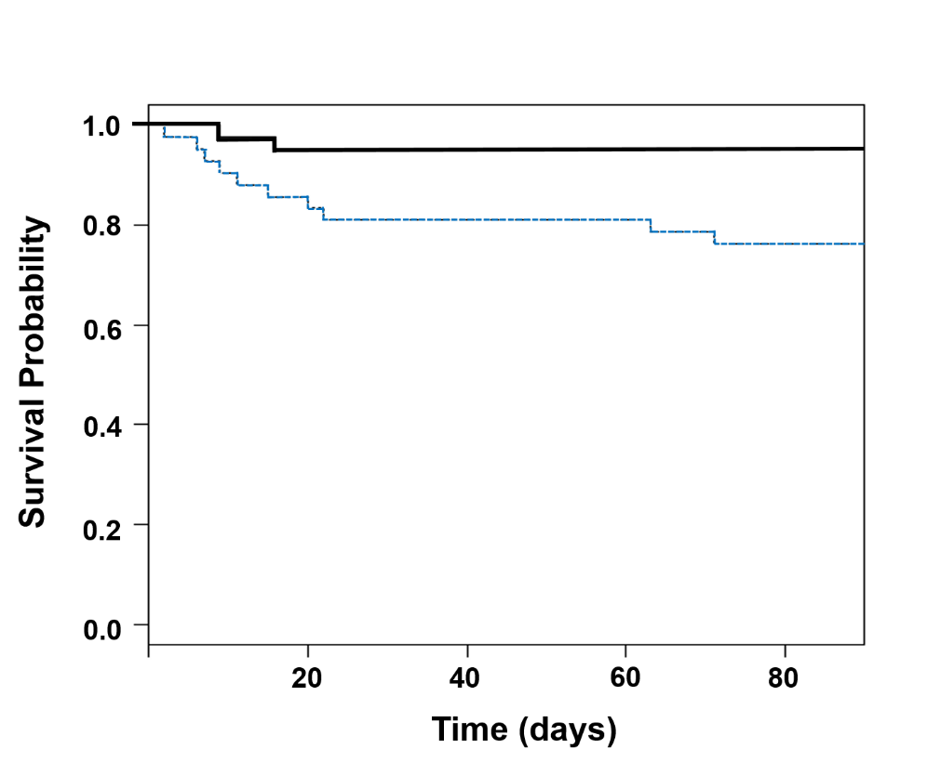
Soluble GPVI is detected in ICU patients and associated with patient mortality
Trauma patients admitted to ICU in Belgium (n=83)
Department of General Intensive Care, Hospital Universitaire de Liège (CHU)
sGPVI low group (≤22.3 ng/mL)
sGPVI high group (>22.3 ng/mL)
Decreased survival probability with higher plasma sGPVI levels at T1
Significant sGPVI associations at T1 with 28- and 90-day mortality

Slide 13

Soluble GPVI is raised in patients with burns injury and is further increased in those who develop sepsis
Longitudinal multi-centre observational cohort study (n=99)
Lead Site: Queen Elizabeth Hospital, Birmingham, UK
sGPVI significantly elevated at day 14 compared to healthy controls (***p<0.005)
Levels of sGPVI are increased in patients that develop sepsis
>Hypercoagulable?
>DIC?

Slide 14
D-dimer levels correlate with sGPVI levels
Variable at T1 | n | r | p-value
Fibrinogen | 83 | 0.29 | ***0.009
Platelet count | 83 | 0.36 | ***0.0008
D-dimers | 82 | 0.41 | ***0.0001
Platelet bound fibrinogen (MFI) | 82 | 0.36 | ***0.0009
D-dimer levels correlate with sGPVI levels at T1 in ICU patients
Spearman’s rank coefficients (n=83)
 | Number of cases | r | p-value
HC | 12 | 0.03 | 0.943
D1 | 49 | 0.17 | 0.242
D3 | 75 | -0.15 | 0.190
D7 | 35 | 0.04 | 0.808
D14 | 44 | 0.46 | **0.002
D21 | 42 | 0.32 | 0.042
D28 | 35 | 0.39 | *0.021
M2 | 33 | 0.44 | *0.011
M3 | 20 | 0.28 | 0.239
M6 | 18 | 0.35 | 0.188
M12 | 12 | 0.27 | 0.387
All time points | 341 | 0.349 | ***<0.0001
D-dimer levels correlate with sGPVI levels at D14
D-dimer level elevations in thermal injury patients (≥15% TBSA) n=61

Slide 15
sGPVI is elevated in a range of thrombotic and inflammatory conditions
Eg – what is the mechanism?
Elevated in:
Ischaemic stroke (Wurster et al. 2013; Platelets, Al-Tamimi et al. 2011; Stroke)
Microangiopathy (Yamashita et al. 2014; Thromb Res)
Rheumatoid arthritis (Gitz et al. 2014; Blood)
ITP (Gardiner et al. 2008; JTH)
DIC (Al-Tamimi et al. 2011; Blood)
Fibrin is a newly recognised GPVI ligand mediating platelet activation (Alsheri et al. 2015; Blood, Mammadova-Bach et al. 2015; Blood)
> Could increased sGPVI in patients be partially mediated by fibrin?

Slide 16
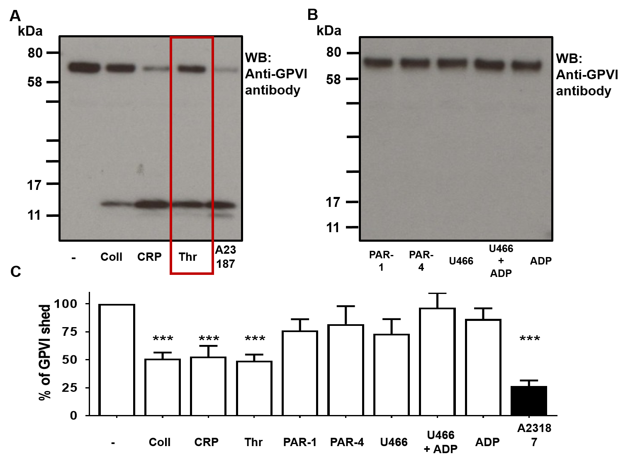
G Protein Coupled Receptor agonists do not induce GPVI shedding
Human washed platelets (5x10⁸/ml)
1 h stimulation under stirring conditions (1200 rpm)
Protease-activated receptor-1 (PAR-1) peptide (SFLLRN)
PAR-4 peptide (AYPGKF)
U46619 =thromboxane mimetic
A23187 = Potent shedder

Slide 17
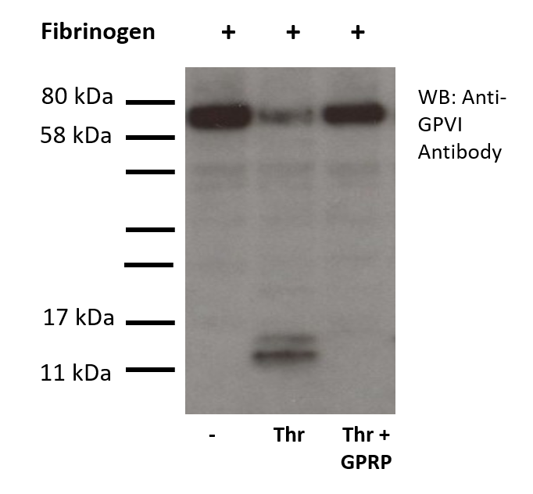
Fibrin stimulation of platelets in suspension induces GPVI shedding and is dependent on polymerisation
Fibrinogen | - | + | + | +
 | - | - | Thr | Thr + GPRP
Fibrin polymerisation photo here?
Polymerised fibrin = thrombin + fibrinogen
Monomeric fibrin = thrombin + (fibrinogen + GPRP)

Slide 18
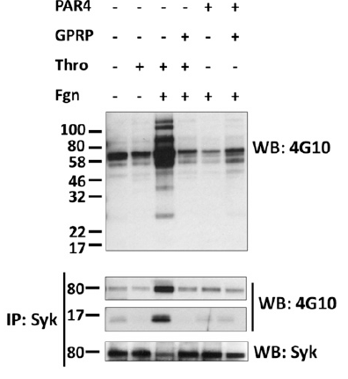
Fibrin generation induces tyrosine phosphorylation in mice platelets including FcR γ-chain and Syk
Thrombin but not PAR4 peptide
induces tyrosine phosphorylation
in the presence of fibrinogen
Blocked by GPRP
(blocks fibrin polymerisation)
Same results with human platelets
Syk
FcRγ
Eptifibatide (αIIbβ3 blocker) present
Alshehri et al. (2015) Blood

Slide 19
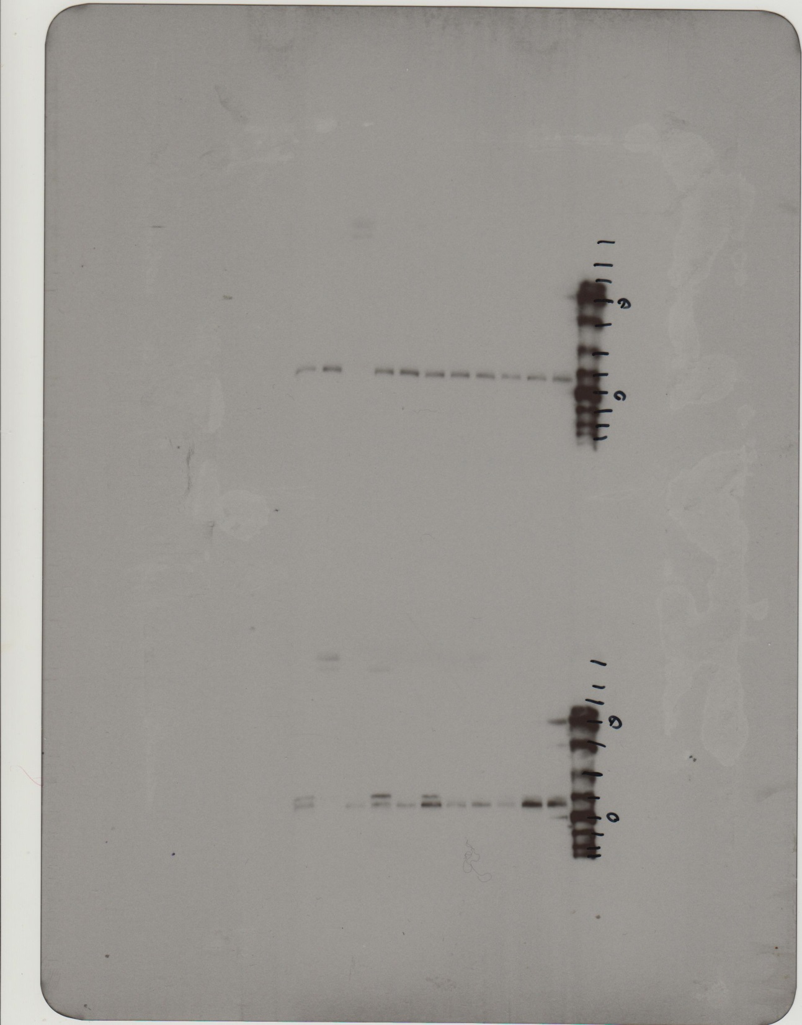
Fibrin mediated GPVI shedding independent of Src and Syk inhibitors and ADAM inhibitors
A
kDa
80
WB: Anti- GPVI antibody
58
Fibrinogen | - | + | + | + | + | + | + | +
Thrombin | - | - | + | + | + | + | + | +
Inhibitor | - | - | - | Das | PRT | GPRP | GI | GM
B
GPRP = inhibitor of fibrin polymerisation
GI254023 = Specific ADAM10 inhibitor
GM6001 = broad MMP inhibitor
Fibrinogen | - | + | + | + | + | + | + | +
Thrombin | - | - | + | + | + | + | + | +
Inhibitor | - | - | - | Das | PRT | GPRP | GI | GM

Slide 20
GPVI shedding conclusions
GPCR ligands do not induce GPVI shedding
Polymerised fibrin induces GPVI shedding, but not monomeric fibrin
Fibrin-mediated shedding is dependent on multiple sheddases including ADAM10
Elevated sGPVI in burns injury and other inflammatory disorders may be partially mediated by fibrin
Factor Xa role/ shear

Slide 22
Project Aims
Overall Aim: Understand the role of platelets in trauma, inflammation and wound repair
Identify the effects of DAMPs and Alarmins on platelet activation
Investigate the cleavage of GPVI and establish whether soluble GPVI is a marker of platelet activation in trauma and inflammation
Explore the consequences of podoplanin upregulation in inflammation
Investigate the role of platelet receptors in wound repair

Slide 23
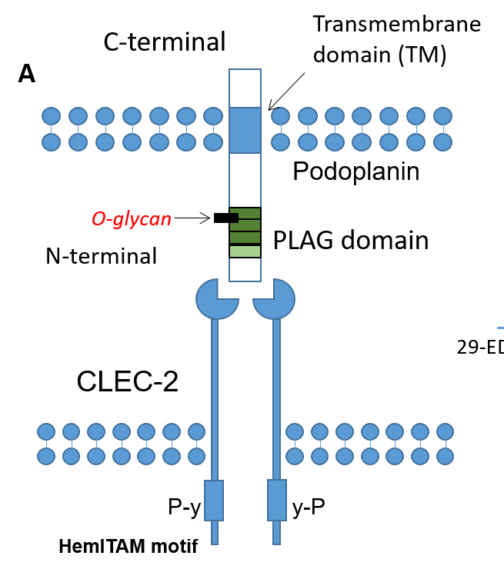
Podoplanin upregulation in inflammation
Podoplanin expressed on:
Kidney podocytes
Alveolar type-1 epithelial cells
Lymphatic endothelial cells
Fibroblastic reticular cells (FRCs)
Platelet/DC cell
Podoplanin upregulation:
T_{H}17 cells (MS)
Tumour cells
Inflammatory macrophages (*mice)
Fibroblasts (Synovium – RA)
36-43kDa
Short cytoplasmic domain
PLAG domain
Platelet aggregation-stimulating domain

Slide 24
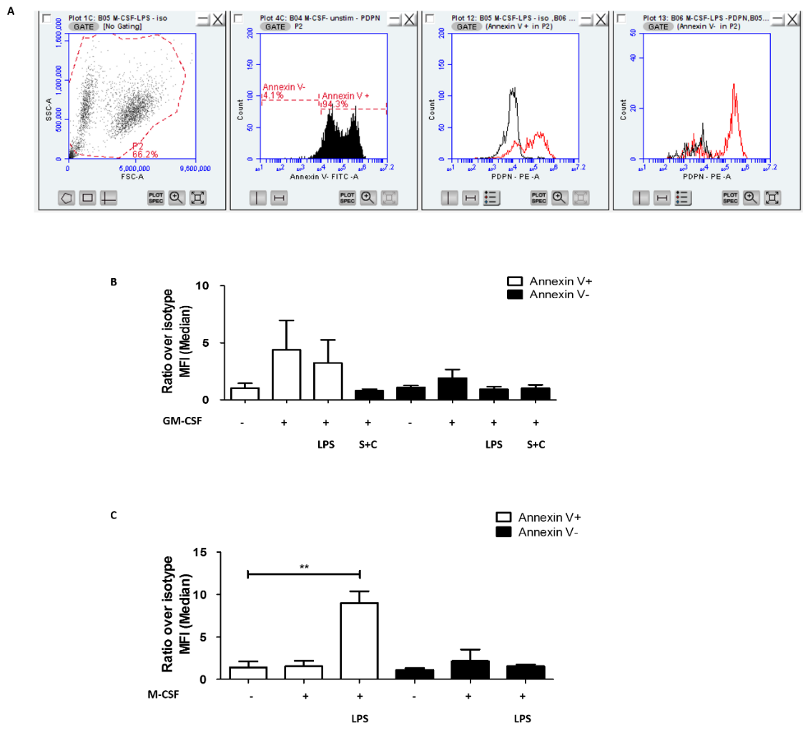
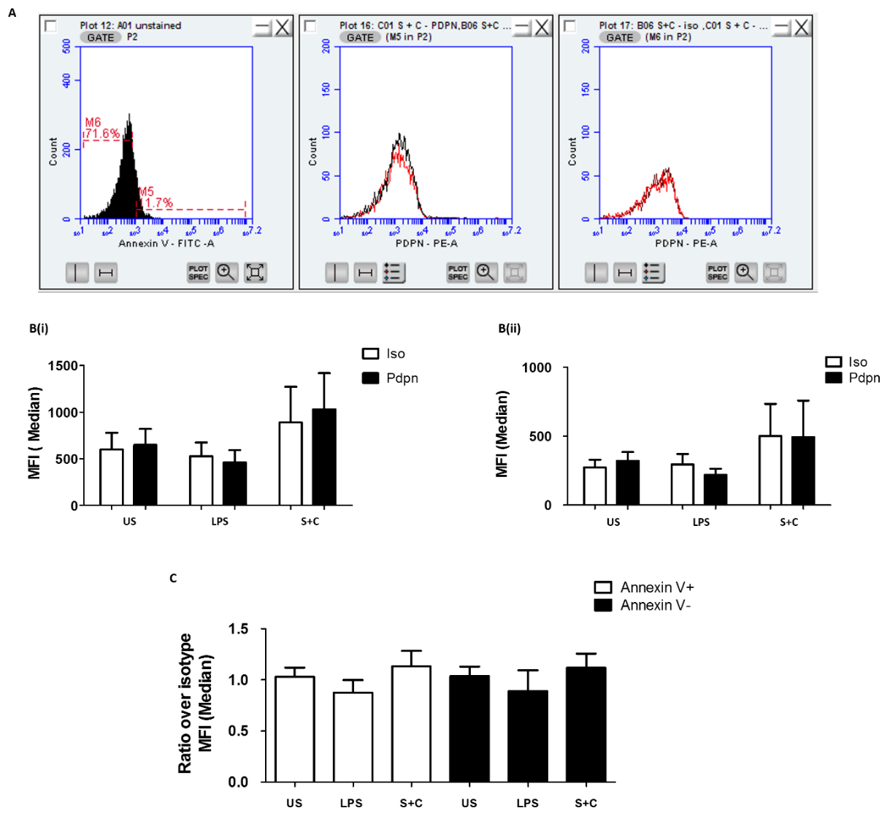
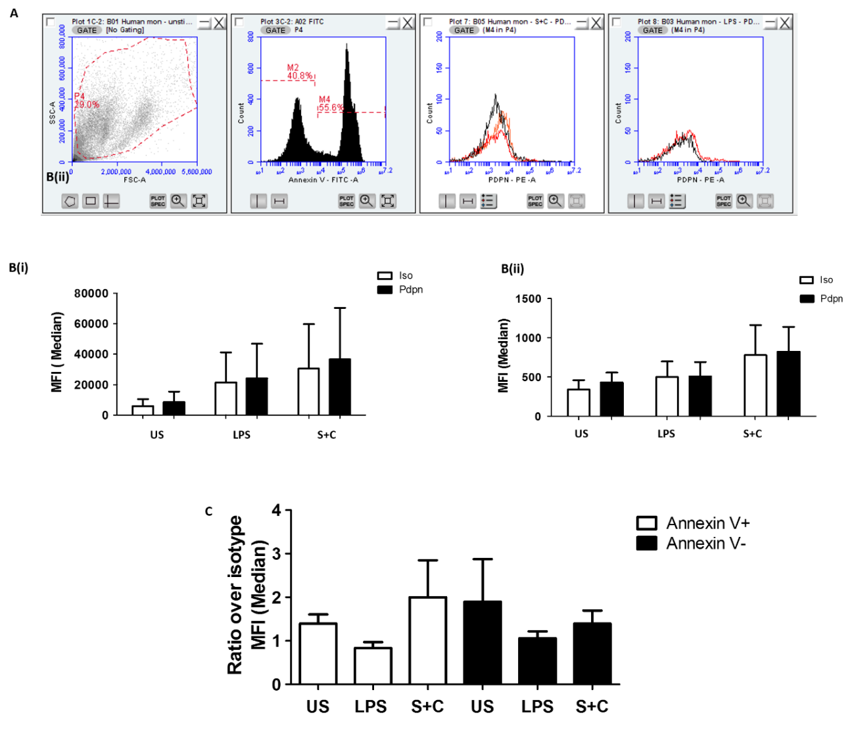
Podoplanin is upregulated on LPS-treated macrophages but not monocytes or PBMCs
PBMCs
Macrophages
Monocytes
Podoplanin is not upregulated in stimulated PBMCs and monocytes
Podoplanin is upregulated in LPS stimulated macrophages

Slide 25
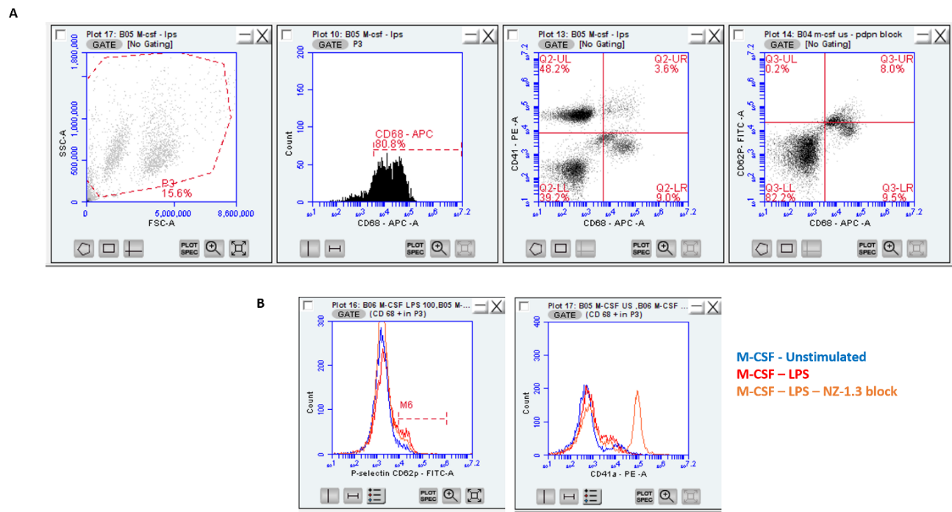
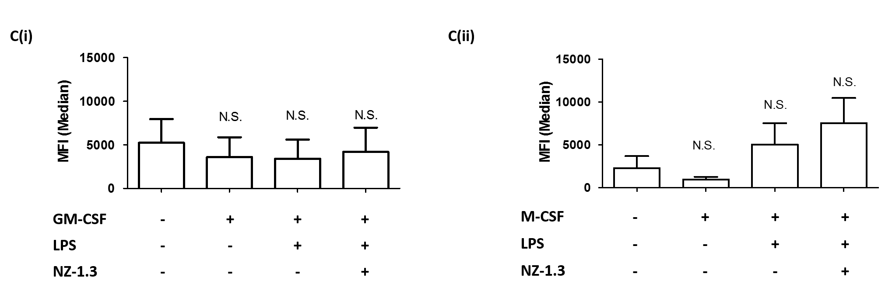
Podoplanin on stimulated macrophages is not sufficient to induce platelet activation
Macrophages + washed platelets
Increases in P-selectin measured
Increased expression represents platelet activation
P-selectin
No significant increases in P-selectin expression on platelets added to macrophages

Slide 26
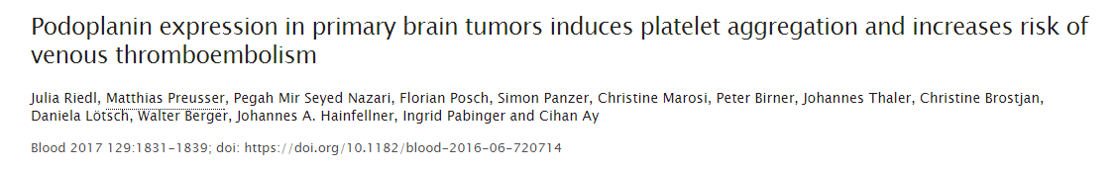
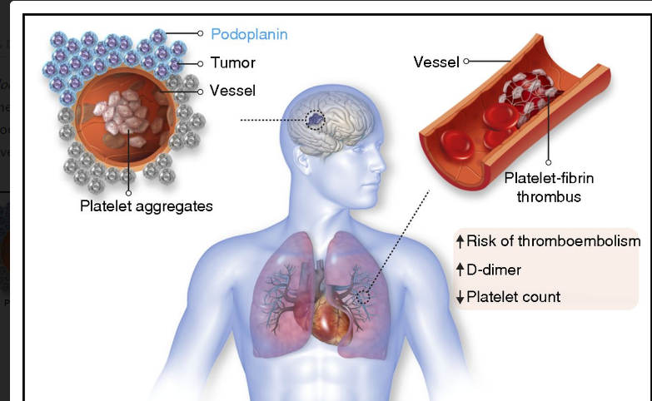
Podoplanin relevance in Cancer
Podoplanin expression in glioma associated with venous thromboembolism
Zwicker J.I, Blood. 2017

Slide 27
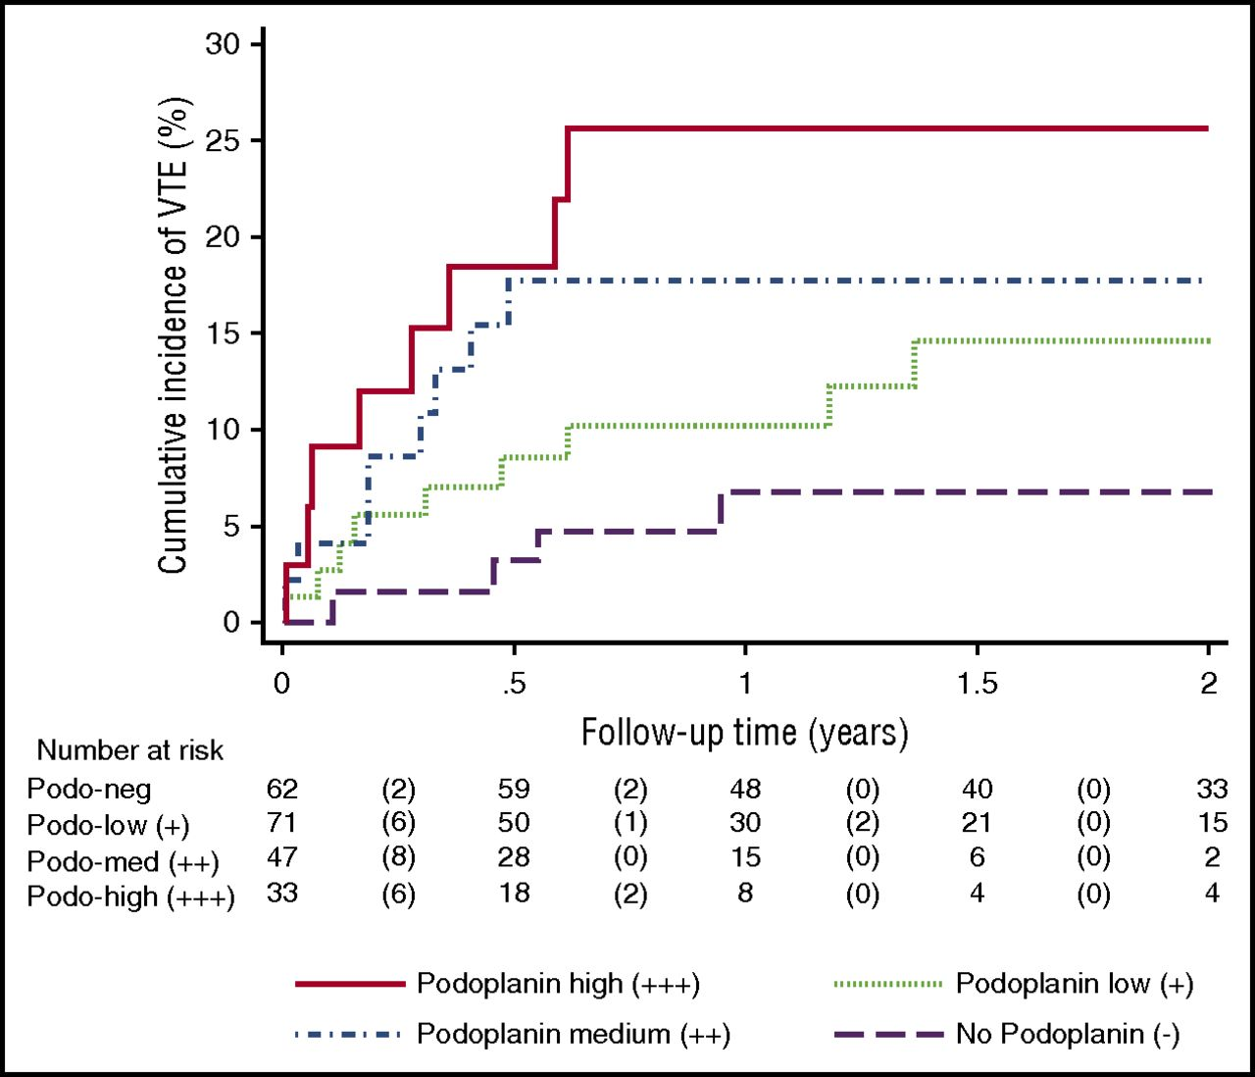
Podoplanin expression in primary brain tumours induces platelet aggregation and increases risk of venous thromboembolism
Brain tumour = high risk of VTE.
Podoplanin expression induces platelet aggregation and is associated with hypercoagulability
Podoplanin expression correlated with high D-dimer and low platelet counts
Cumulative incidence of venous thromboembolism (VTE) according to podoplanin expression
Riedl J. et al. 2017. Blood

Slide 28
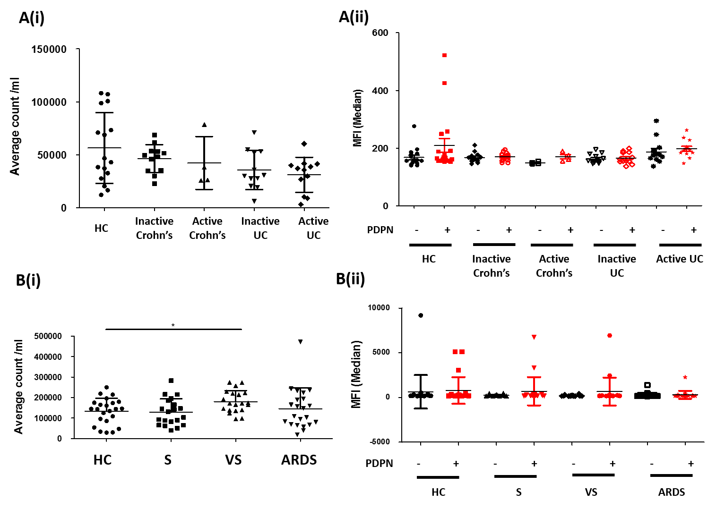
Podoplanin measurements on microvesicles (MVs) of patients with inflammation
=>Could podoplanin expressed on microvesicles in brain tumour patients lead to platelet activation?

Slide 29
Podoplanin upregulation conclusions
Podoplanin is upregulated on LPS-treated macrophages (human) but not monocytes or PBMCs
Podoplanin on stimulated macrophages is not sufficient to induce platelet activation
Podoplanin is not upregulated on microvesicles in patients with inflammation
But could be in the brain tumour patients/cancer patients?

Slide 30
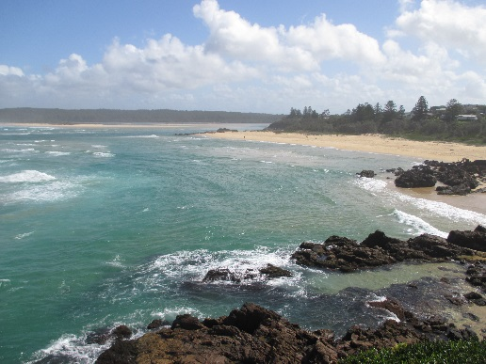
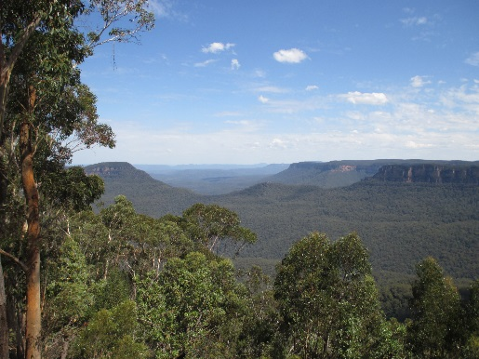
Why am I here?
Cancer cell interactions with platelets
Platelet receptor regulation
Learn new techniques/
New field of interest

Slide 31

Goals
See a koala bear and kangaroo
Interactions between platelets and cancer (Sarah Hicks)
Pdpn/CLEC-2
Other receptors involved
Effects of cancer cells on platelet function and visa versa
Does shear play a role?
Regulation of platelet receptors
Complete fibrin shedding story
Factor X role/shear effect

Slide 32




Acknowledgements
Birmingham Platelet Group
Steve Watson
Gerard Nash
Surasak Wichaiyo
Eelo Gitz
Brenda Finney
Osama M Alshehri
Najiat Sarker
Natalie Poulter
All other Watson group members + students
Australian National University– Canberra
Elizabeth Gardiner Sarah Hicks
Christine Lee Karena Pryce
Monash University – Melbourne
Robert Andrews
UoB Division of Infection & Immunity
Robert Dinsdale
Paul Harrison
Peter Hampson , Chris Wearn , Janet Lord
Hema Chahal, Hannah Smith, Ashleigh Evans
Jon Bishop
QEH – Gastroenterology department Tariq Iqbal
Abhishek Chauhan
QEHB Burns centre and research team
Naiem Moiemen
Amy Bamford
Maastricht University
Johan Heemskerk & Lab members

Slide 34
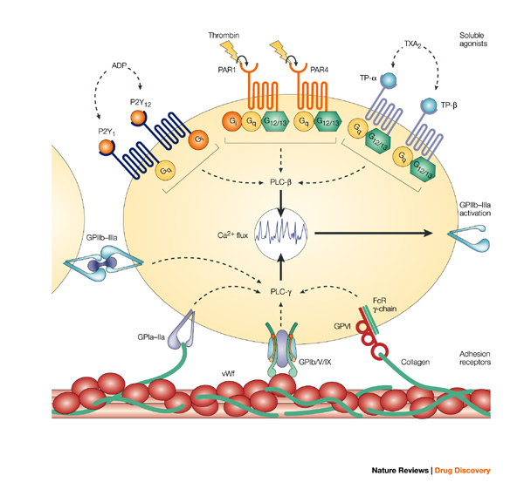
Platelet Surface Receptors
GPCRs
GPCRs
GPCRs
ITAM

Slide 35
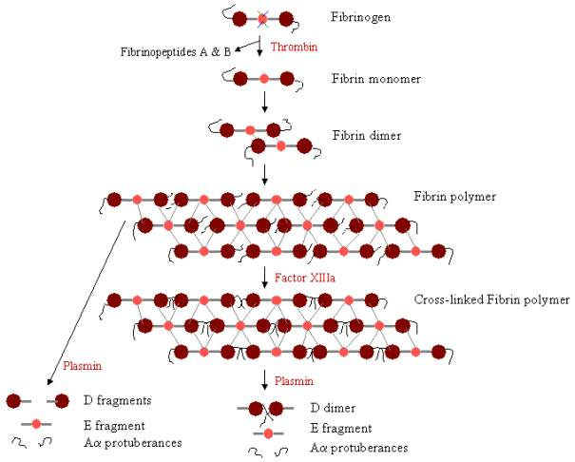
GPRP

